Slide 1
atm interface
Submitted To
Pooja Mehta
Submitted by
y.tanuja

Slide 2
Introduction
Some Basic Concepts
Scanner Class
Method
Inheritance
Exception handling
Decimal Formatting
HashMap
Output Screenshots

Slide 3
Introduction
ATM Means Automatic Teller Machine.
This ATM project is used to access their bank accounts in order to perform Withdraw , Deposit, Balance Enquiry of both current and savings accounts.
Whenever user want to perform these actions they need to enter valid customer number and pin.

Slide 4
Some Basic Concepts
Switch: switch statement executes one statement based on the user requirement from multiple conditions.
If-else: if the condition true then only executes if block otherwise it executes else block
Do-while: It is used to iterate a part of the program repeatedly, until the specified condition is true. This do-while loop to execute the loop at least once.

Slide 5
Scanner
In java Scanner class is used to read input from Keyboard .
Scanner class is Available in java.util package
To read console input we have to construct a Scanner object.
Scanner s=new Scanner(System.in);
Scanner class have some methods like next(), nextInt(), nextFolat() …..e.tc.
In this Project by using scanner class, I read user account number , pin, ……e.t.c.

Slide 6
Method
A Method is a block of code which only runs when method is called.
Methods are used to perform certain tasks.
The usage of methods is to reuse the code.
Create a Method → Method name followed by parenthesis();
Call a Method → write method name followed by parenthesis and a semicolon;
I am using methods concept to achieve the functionality of withdraw, deposit, balance checking……………e.t.c...

Slide 7
Inheritance
Inheritance is the process where one class acquires the properties (methods and fields) of another.
I am using single inheritance in this ATM Interface

Slide 8
Exception
Java Exception Handling is a mechanism to handle runtime errors.
Java custom exceptions are used to customize the exception according to user need.
Here I am using custom exception for maintain minimum balance while withdrawing the amount and IOException while taking input.

Slide 9
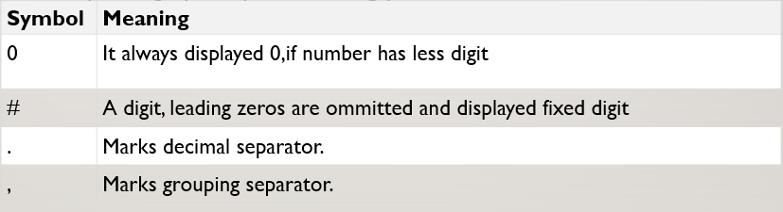
Decimal Format
DecimalFormat class is subclass of NumberFormat class and it is used to format numbers by using specify formatting pattern.
For displaying the amount I am using the format is ###,##0.00

Slide 10
HashMap
HashMap provides the basic implementation of the Map Interface.
It stored the data in (Key, Value) Pairs.
HashMap takes two parameters they are:-
1.The Type of Keys maintained by this map
2.The type of mapped values.
Checking Whether the user entered customer number exists or not and they entered valid or invalid pin of that particular customer number .

Slide 11
OUTPUT SCREEN SHOTS

Slide 12
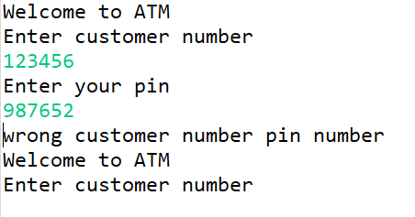
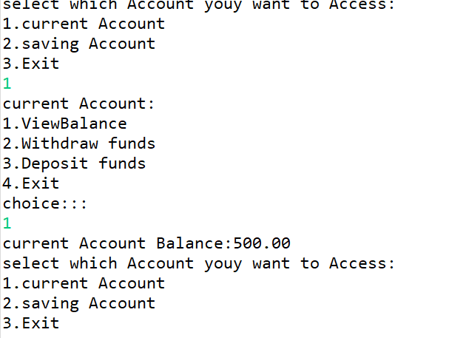
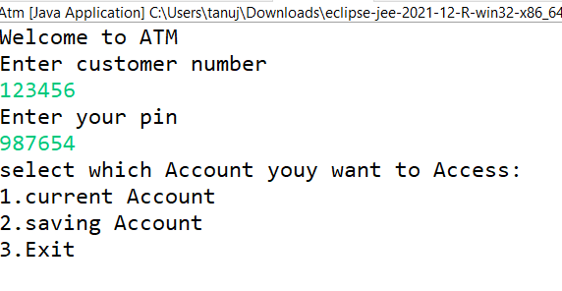

Slide 13
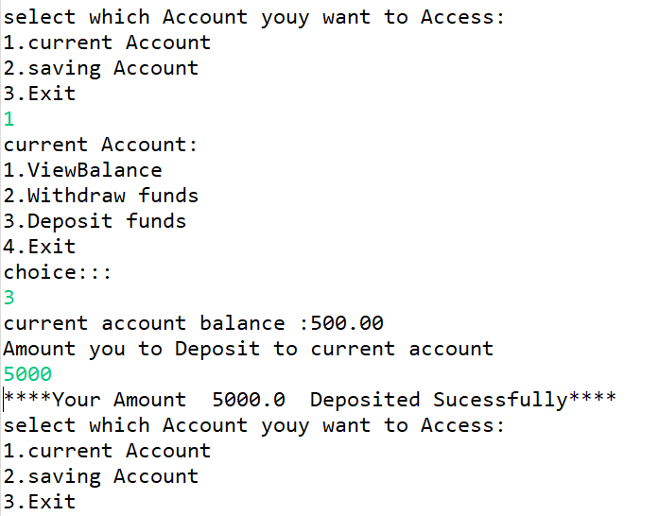
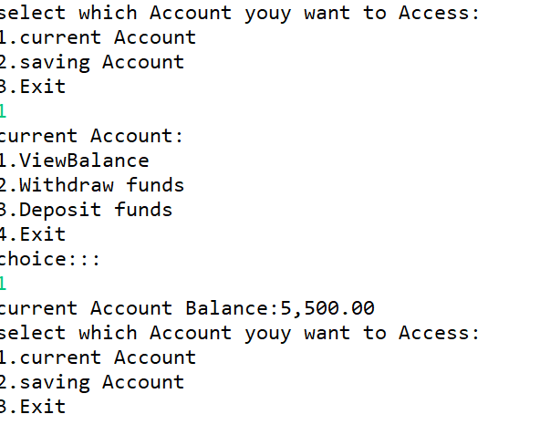

Slide 14
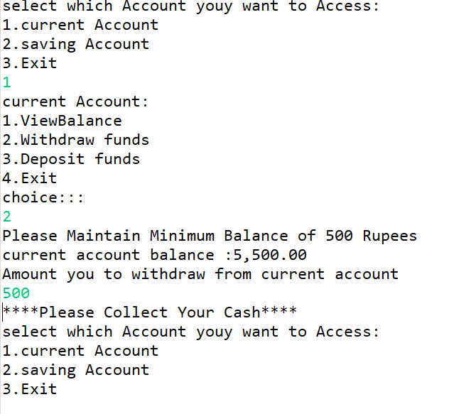
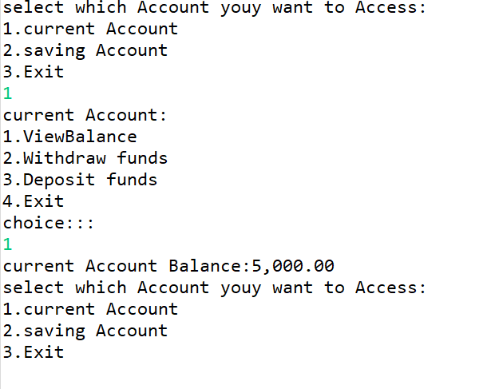

Slide 15
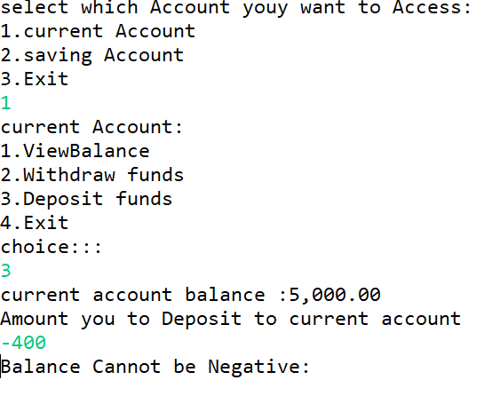
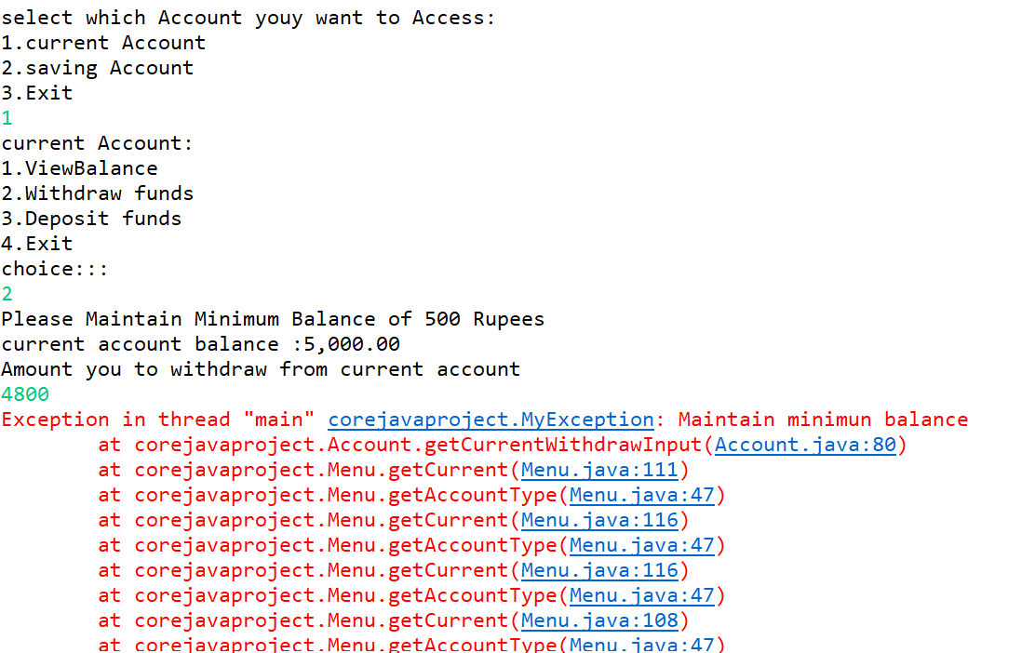

Slide 16
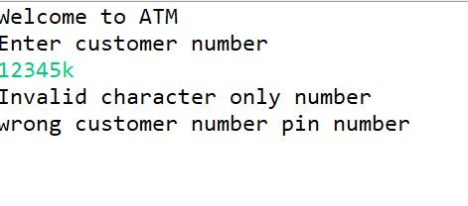
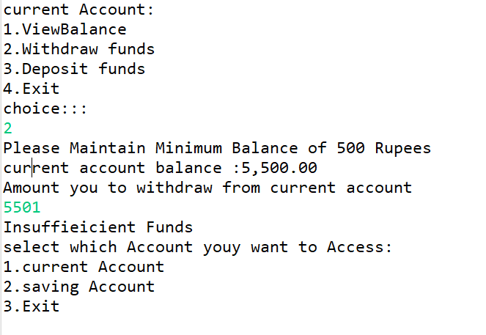

Slide 17


